Slide 1
The effect of perturbation re-centring on ensemble forecasts
Simon Lang, Martin Leutbecher, Massimo Bonavita

Slide 2
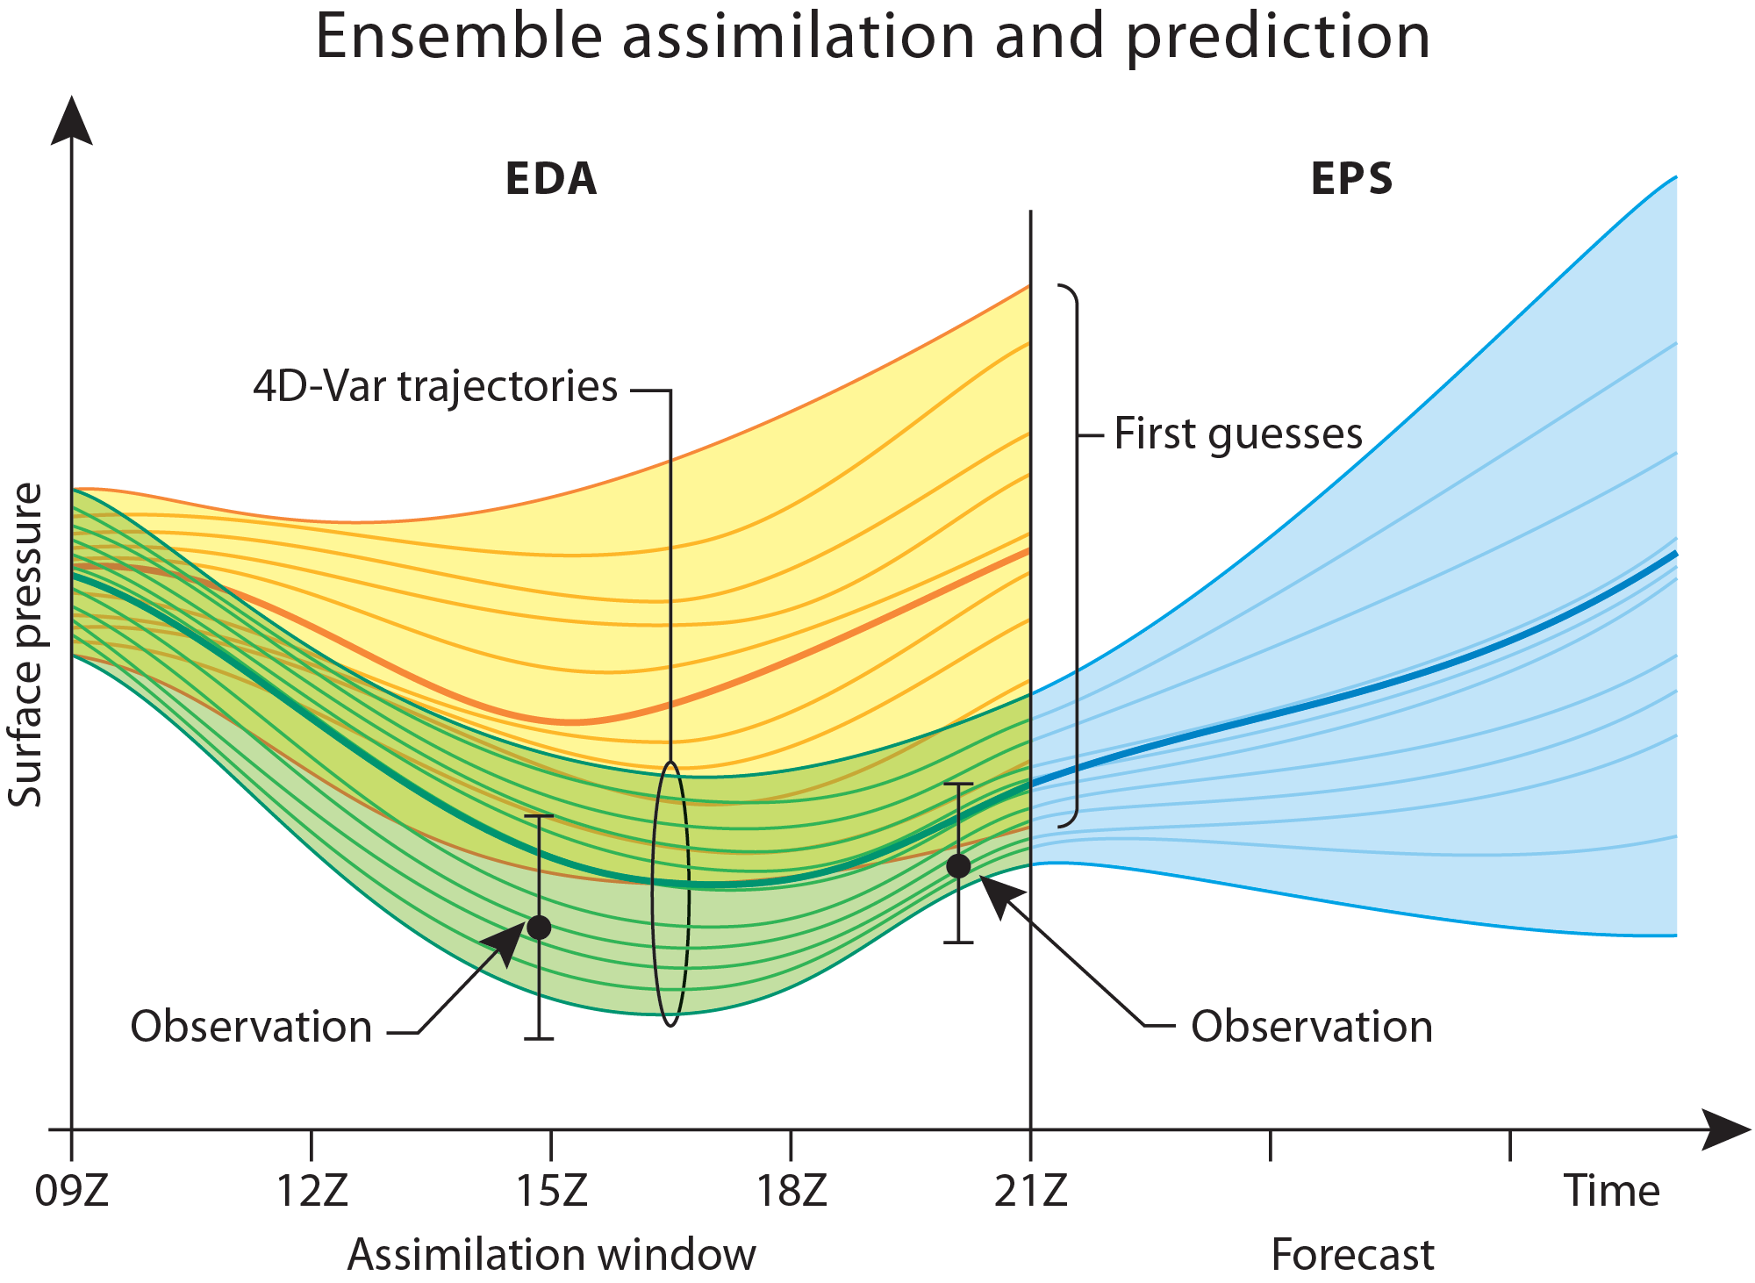

Slide 3
Initialization of the EPS
The ensemble of data assimilations (EDA) is used to estimate analysis uncertainty for the ensemble.
In the current configuration the EDA perturbations are re-centred on the high resolution high quality analysis.
This is done because:
The EDA is run at lower resolution and in a computationally cheaper configuration (outer loops, inner loops, etc.)
The EDA is run in delayed mode; 6h-FCst are used for the ensemble to generate the perturbations (to save computational resources in the time-critical path of the operational schedule, thus an updated EDA is not available when ensemble is started)

Slide 4

Generation of initial conditions for the ensemble:
Oper : EDA 6h fcsts
In the following: EDA at analysis time
Re-centre EDA-Distribution on Hres-Analysis
SVPERT_{j} : individual linear combination of all extra-tropical singular vectors and singular vectors targeted on tropical cyclones
NSET : nhem, shem, TCs1-6, NSV : 50 or 5 (TCs)

Slide 5
Setup of Experiments:
EDA_{Control}
EDA_{Control}
vs
Compare ensemble started from EDA members with ensemble re-centred on EDA control (to eliminate impact of higher resolution centre analysis)
EDA at analysis time is used

Slide 6
Experiments
Ensemble Experiment identifiers: (all 51 members, TL639L91, up to +5d)
EDA, 25 members, TL399, 137 levels | all obs (oper) | reduced-obs
Method 1 : start from EDA an | MEAN | MEAN-RED
Method 2 : recentre on EDA-control an | REC | REC-RED
Method 3 : recentre on HRES an | REC-Hres
Initial perturbations:
- singular vectors, 48h opt time time, T42
- perturbations from the Ensembles of Data Assimilation (EDA) T_{L}399L137, 25 Members
Model uncertainties: SPPT and SKEB
Hres Analysis used for verification! 1.5 Lat-Lon Grid

Slide 8
Ratio of mean kinetic energy of perturbed members

Slide 9
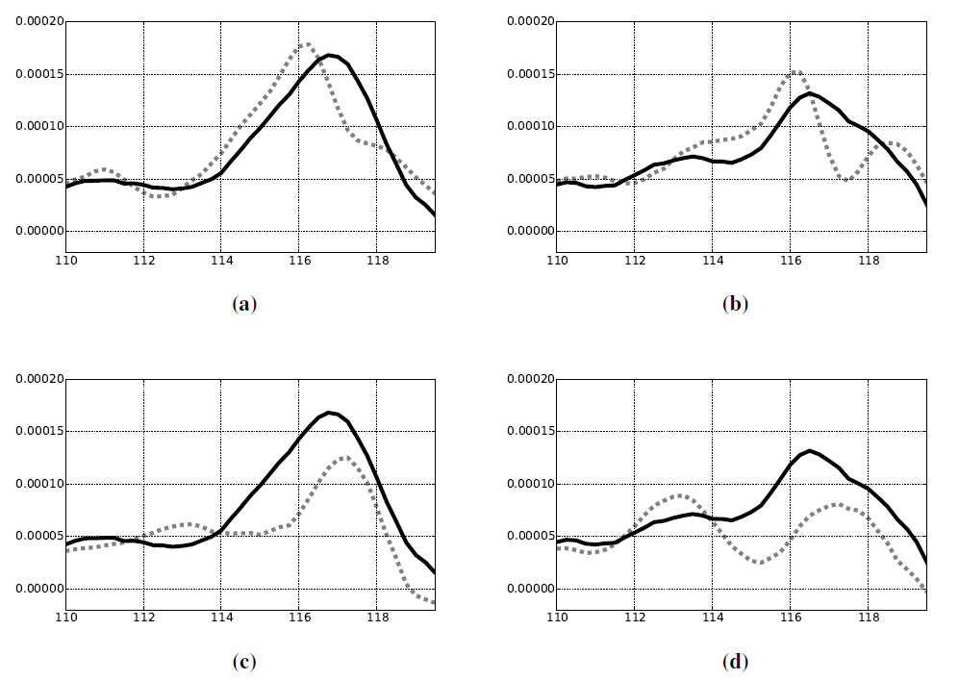
Relative vorticity at 850 hPa Typhoon Wutip (2013)
27-12-2013 00 UTC – cut along latitude 15.5
Ensemble mean (black), perturbed member (grey)
Mean
Rec
Member 13
Member 23

Slide 10
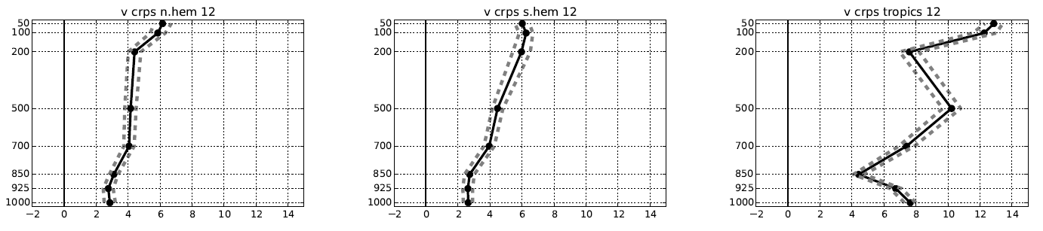
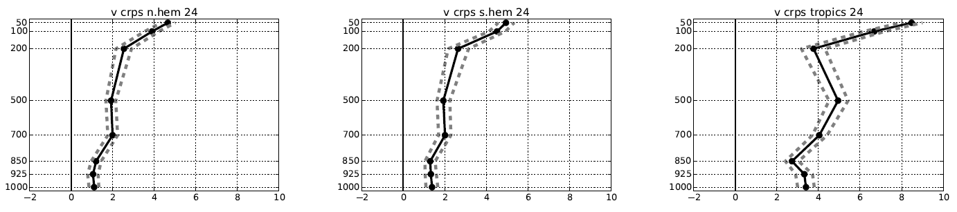
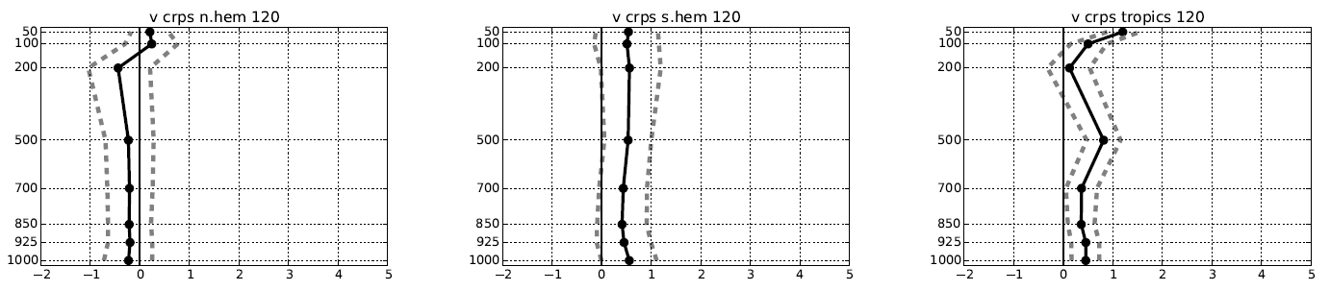
Improvement in terms of CRPS of experiment MEAN vs REC
12h
24h
120h

Slide 11
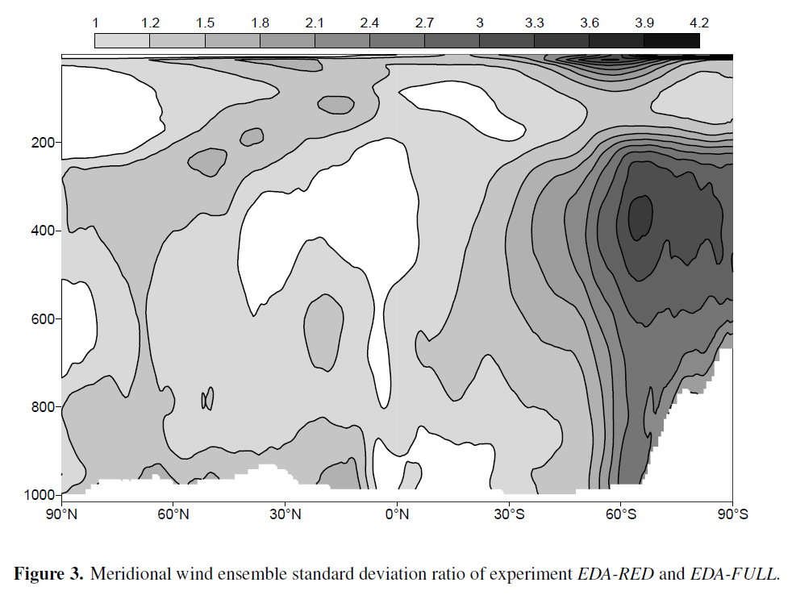

Slide 12
Ratio of mean rotational kinetic energy of perturbed members

Slide 13
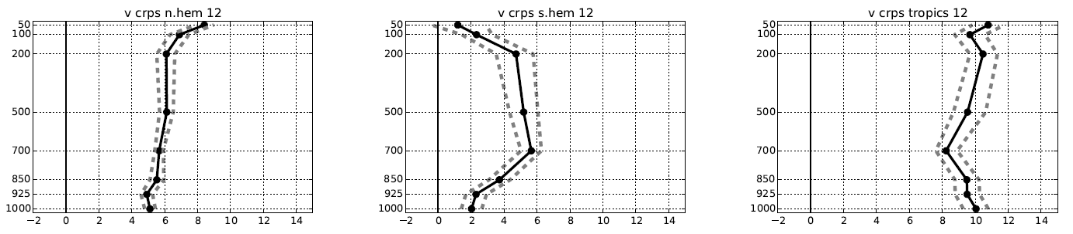
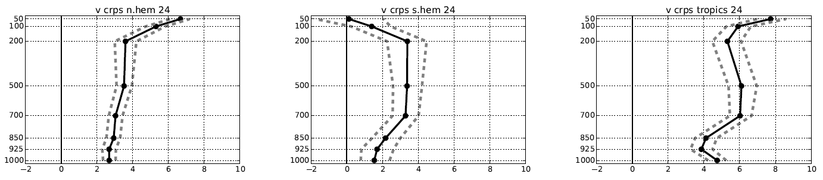
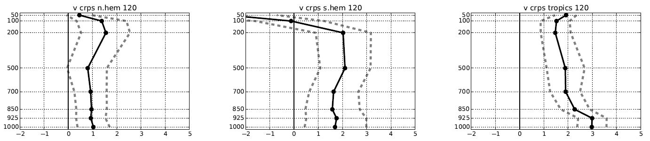
Improvement in terms of CRPS of experiment MEAN-RED vs REC-RED
12h
24h
120h

Slide 14
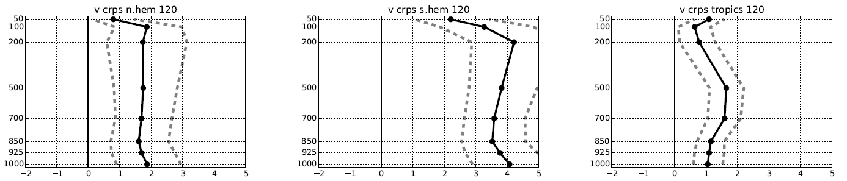
Improvement in terms of CRPS of experiment REC-HRES vs REC
120h
Re-centring on HRES Analysis very beneficial because of higher quality analysis:
Higher resolution and more outer loop
Higher resolution inner loops
Flow dependent background error covariances
…
-> depends on EDA setup

Slide 15
Improvement in terms of CRPS of experiment REC-HRES vs REC
120h

Slide 16
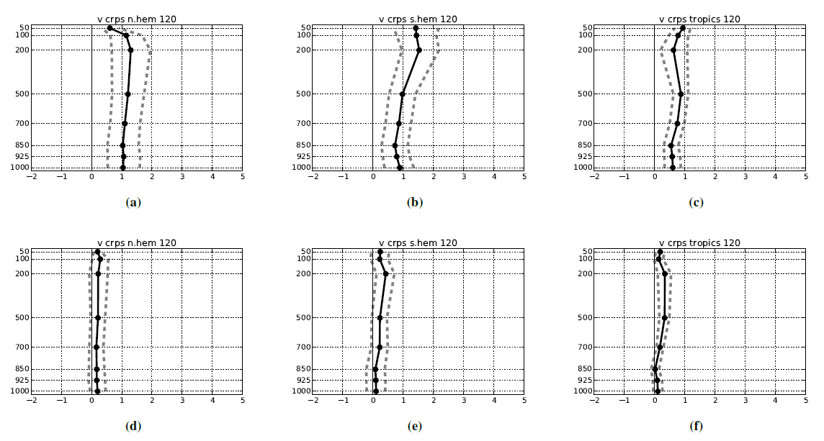
Improvement (CRPS) of experiment MEAN 5 vs 25 EDA members and REC 5 vs 25 EDA members
Only 5 EDA member used for def. perturbations and EDA ensemble mean
120h
120h
120h
MEAN
REC

Slide 17

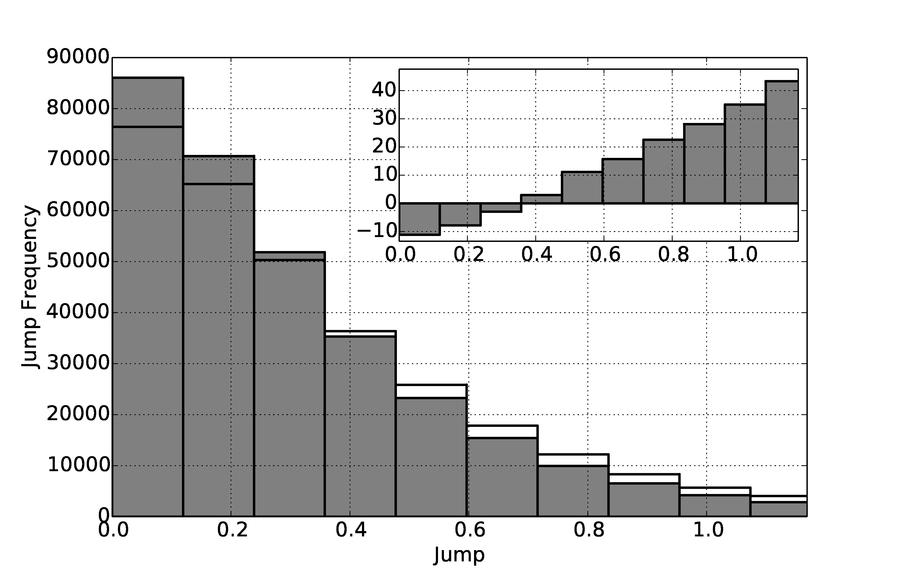
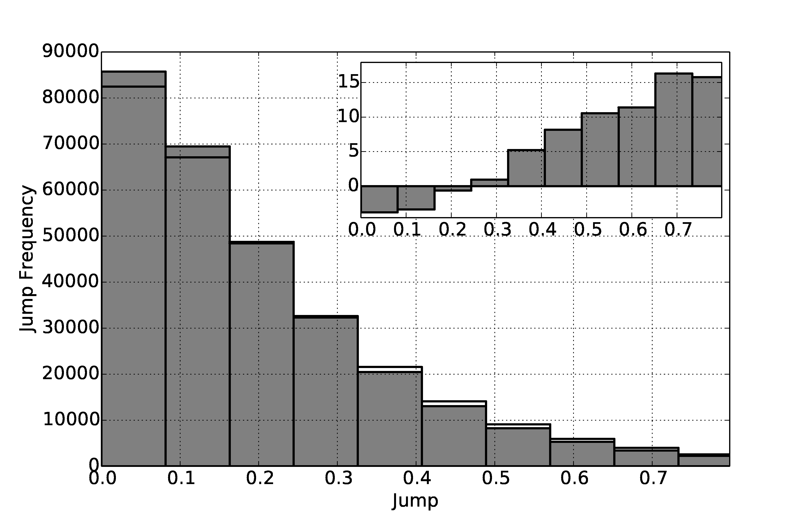
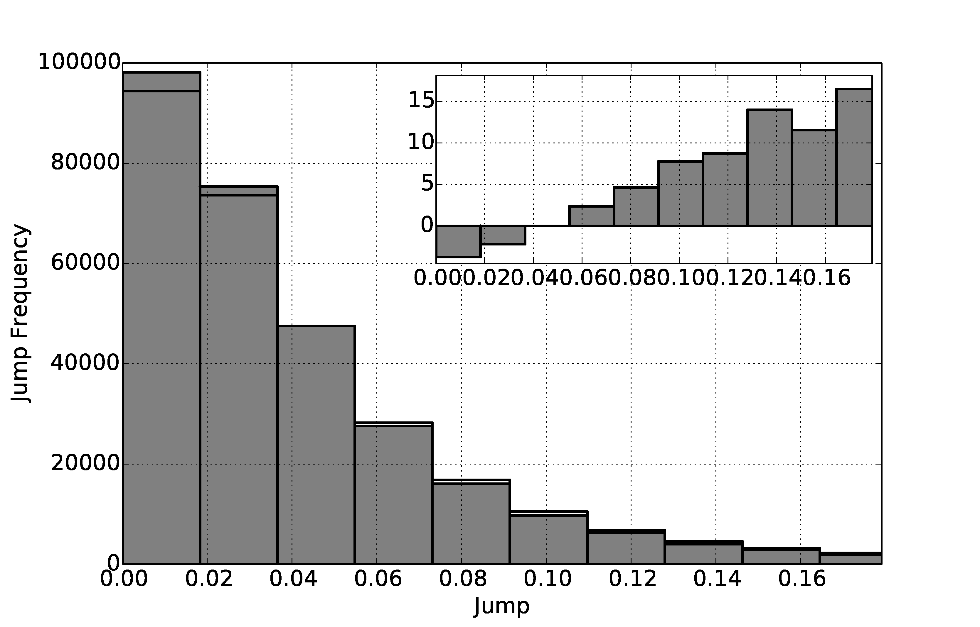
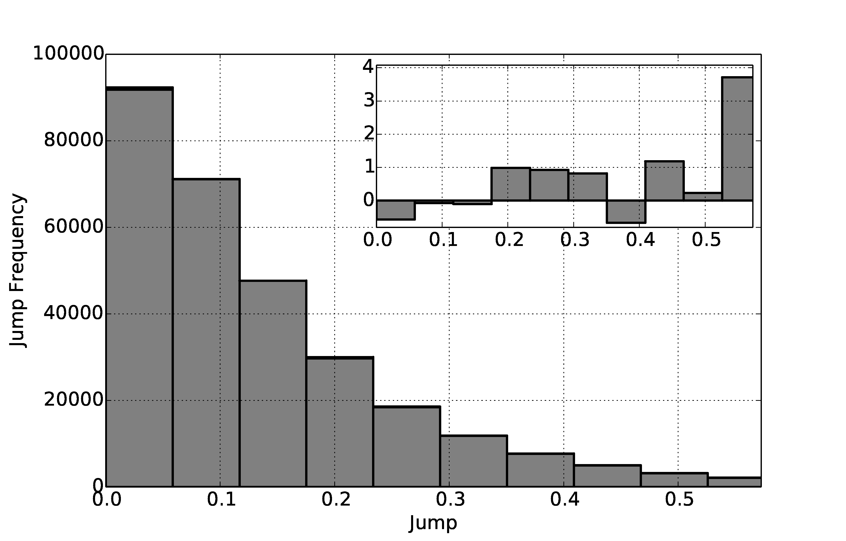
Impact on Jumpiness:
-> absolute difference of ensemble means from subsequent forecasts valid at the same time
Tropics
12 (0)
v200hPa
24 (12)
v200hPa
SH.ext-tropics
12 (0)
z500hPa
96 (84)
z500hPa

Slide 18
Impact on precipitation frequency
Relative increase (percent) of the frequency of 12 h accumulated precipitation in the first 12 h of the forecast. a) tropics, b) Northern Extratropics
-> Re-centring impacts precipitation frequency during first 12h of the forecast

Slide 19
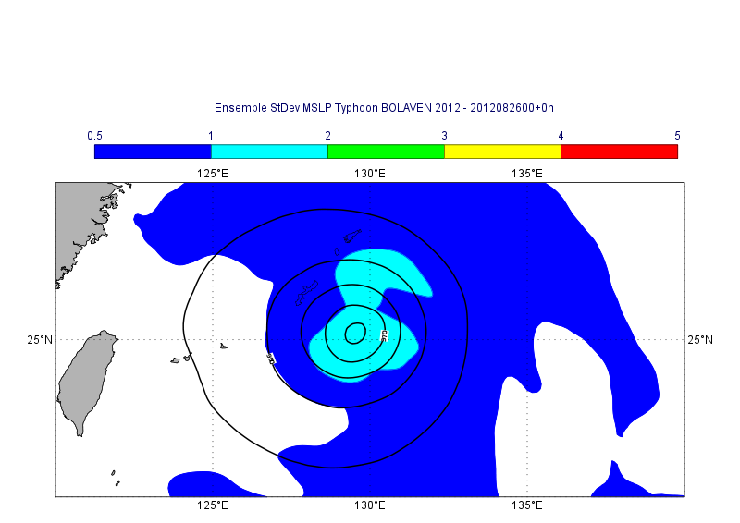
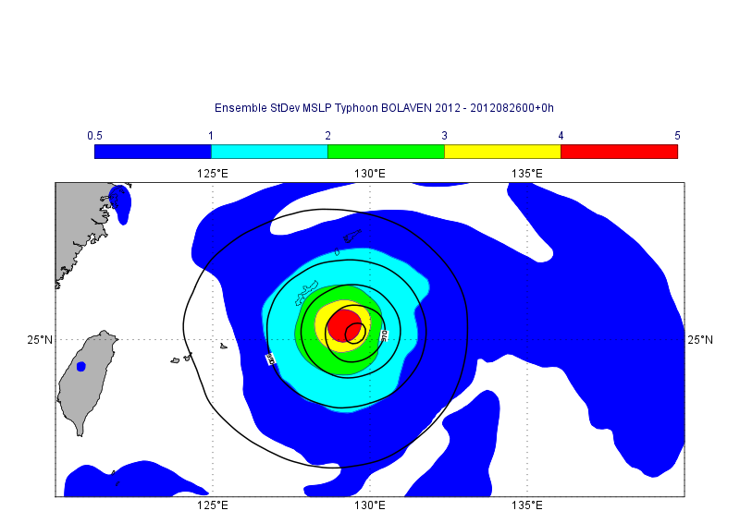
Typhoon BOLAVEN 2012 – MSLP ENS StDev
Ensemble with perturbations from TL399 EDA
Ensemble with perturbations from TL639 EDA

Slide 20
Summary and Discussion
Starting from the perturbed EDA members is desirable (re-centring can increase the variance of the perturbed members).
Omitting the re-centring step has an large impact at shorter lead times (large improvement in terms of probabilistic scores (e.g. CRPS).
Starting directly from the pert. EDA members reduces jumpiness
Re-centring leads to a spurious modification of the precipitaion frequency during the first 12 h of the forecast
How long the impact is felt depends on the scale and amplitude of the perturbations
Better centre analysis can counteract negative effects of re-centring
Benefit of more EDA members less visible when re-centring
Under-dispersive of EDA and other perturbation methods (SVs, stochastic physics) might still mask the full benefit
“Applications”:
small scale severe weather
scalability: EDA members run in parallel
limited area ensembles nested in ECMWF’s ensemble
Lang, S. T. K., Bonavita, M. and Leutbecher, M. (2015), On the impact of re-centring initial conditions for ensemble forecasts. Q.J.R. Meteorol. Soc.. doi: 10.1002/qj.2543

Slide 21
Additional Slides

Slide 22

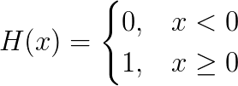
Continuous ranked probability score (CRPS):

Slide 23
Operational schedule
Early delivery suite introduced June 2004
02:00
03:30
14:00
15:30
12h 4D-Var, obs 09-21Z
12h 4D-Var, obs 21-09Z
04:00
06 UTC analysis
16:00
18 UTC analysis
3hFC
6h 4D-Var
21-03Z
3hFC
6h 4D-Var
9-15Z
03:40
04:40
15:40
16:40
00 UTC analysis (DA)
12 UTC analysis (DA)
T1279 10 day forecast
T1279 10 day forecast
18:05
06:05
51*T639/T399 EPS forecasts
51*T639/T399 EPS forec.
05:00
06:35
17:00
Disseminate
Disseminate
Disseminate
Disseminate
Disseminate
from L. Isaksen

