Slide 1



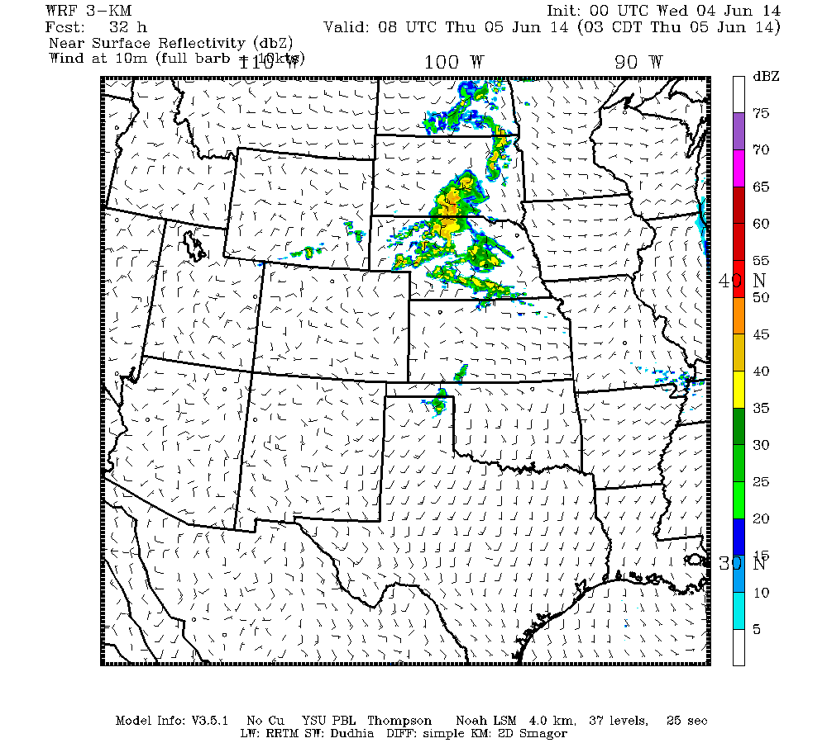
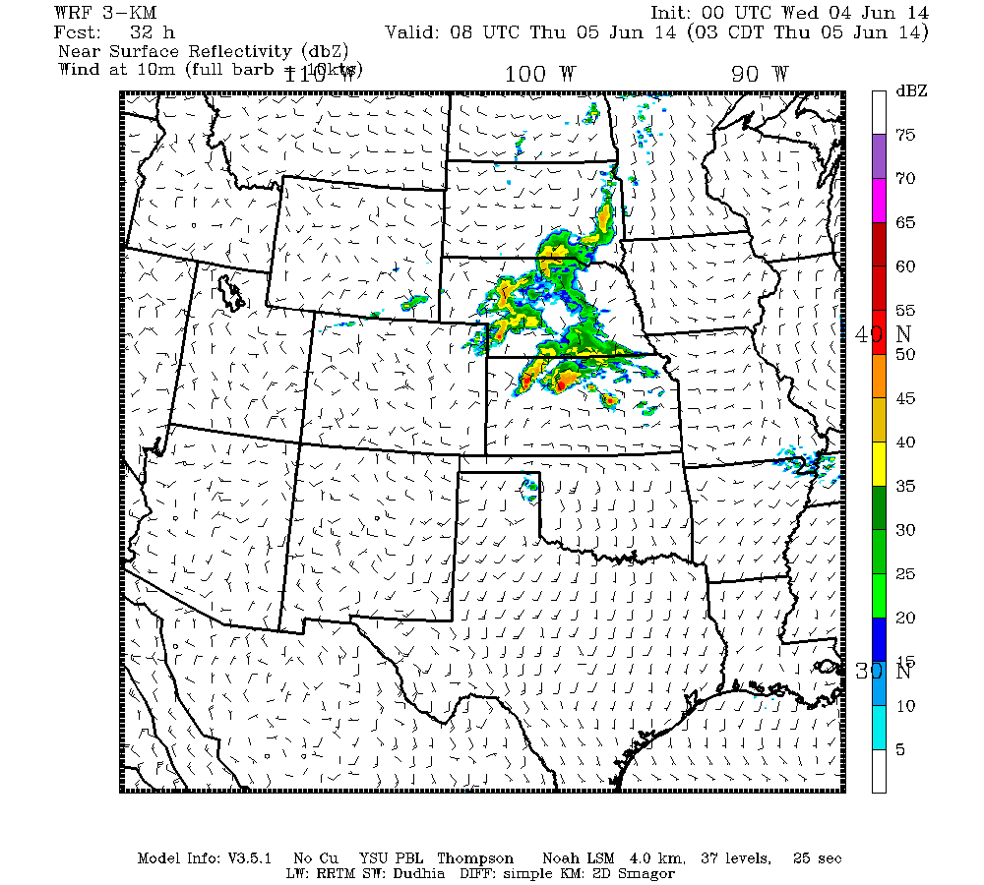
The Use of Ensemble-Based Sensitivity with Observations to Improve Predictability of Severe Convective Events
Brian Ancell, Aaron Hill, and Brock Burghardt
(Texas Tech University)
Workshop on Meteorological Sensitivity Analysis and Data Assimilation
(The 10th Adjoint Workshop)
Roanoke, West Virginia
June 1-5, 2015

Slide 2

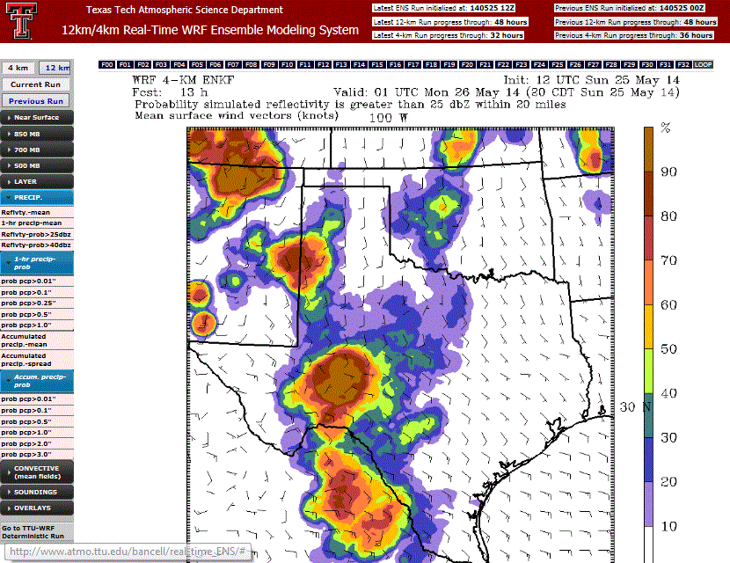
Motivation
The capability now exists to run real-time, high resolution ensemble data assimilation/forecasting systems
→ TTU WRF DART system runs 36hr
forecasts with 25 members at 4km grid spacing

Slide 3
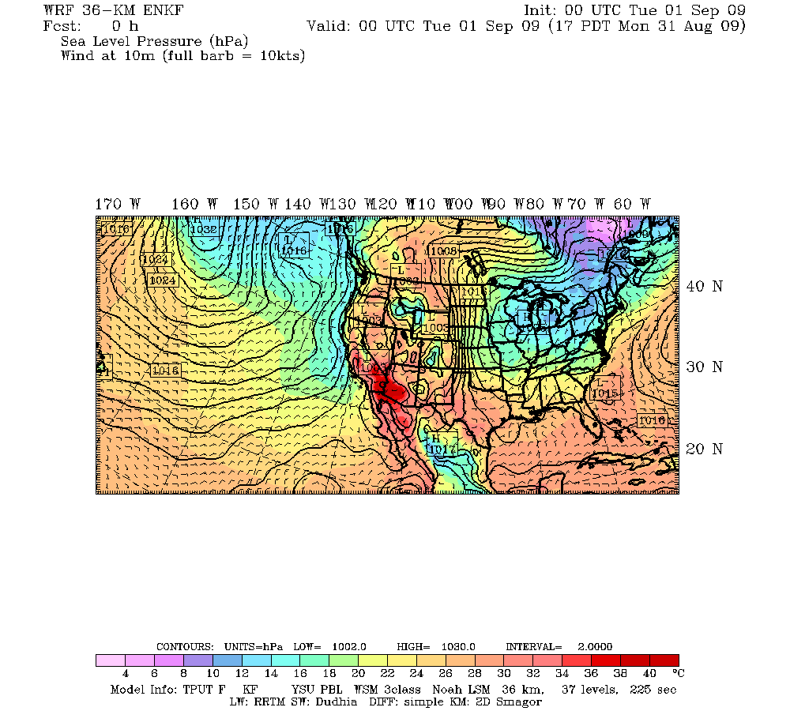
Motivation
The capability now exists to run real-time, high resolution ensemble data assimilation/forecasting systems
→ TTU WRF DART system runs 36hr
forecasts with 25 members at 4km grid spacing
4km
Upcoming expansion for
SPC needs
(summer 2015)
36km

Slide 4
Motivation
The Problem: Computational expense still forces relatively infrequent extended forecast initializations (e.g. 12 hrs, even with 6-hr cycling time)

Slide 5
Motivation
The Problem: Computational expense still forces relatively infrequent extended forecast initializations (e.g. 12 hrs, even with 6-hr cycling time)
→ Large amounts of observational information go unused with regard to extended forecasts

Slide 6
Motivation
The Problem: Computational expense still forces relatively infrequent extended forecast initializations (e.g. 12 hrs, even with 6-hr cycling time)
→ Large amounts of observational information go unused with regard to extended forecasts
The Question: Can we choose ensemble subsets (using comparisons to early-forecast time observations) in a smart way (using ensemble sensitivity) to improve the prediction of high-impact events?

Slide 7
Motivation
Ensemble Members
Truth
00-hr
24-hr
Key: Ensemble spread grows large relative to observation errors
→ Comparisons of members to observations become meaningful

Slide 8
Motivation
Ensemble Members
Truth
00-hr
24-hr
Key: Ensemble spread grows large relative to observation errors
→ Comparisons of members to observations become meaningful

Slide 9
Motivation
Ensemble Members
Truth
00-hr
24-hr
Key: Ensemble spread grows large relative to observation errors
→ Comparisons of members to observations become meaningful
Two asepcts helping this technique:
1) High-impact events typically associated with rapid growth of ensemble spread
2) We have a way to identify where errors matter → ensemble sensitivity!

Slide 10
Ensemble Sensitivity
The Basic Recipe:
1) An ensemble of forecasts
2) The choice of a response function (R) at a forecast time
Slope = ∂R/∂Xo
→Ensemble Sensitivity
Linear Regression
= Covariance(R,X_{o}) / Variance(X_{o})
R
X_{o} (initial state)

Slide 11
Ensemble Sensitivity
The Basic Recipe:
1) An ensemble of forecasts
2) The choice of a response function (R) at a forecast time
Slope = ∂R/∂Xo
→Ensemble Sensitivity
Linear Regression
= Covariance(R,X_{o}) / Variance(X_{o})
Provides dynamical link to pure dynamical sensitivity
R
X_{o} (initial state)
(∂R/∂Xo)_{ENS}= D⁻¹A(∂R/∂Xo)_{ADJ}

Slide 12
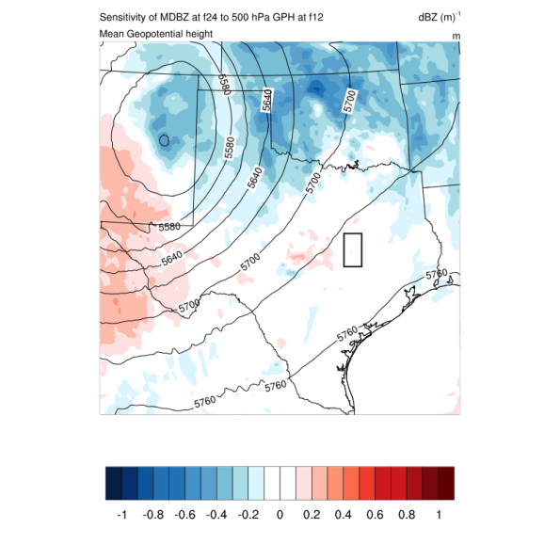
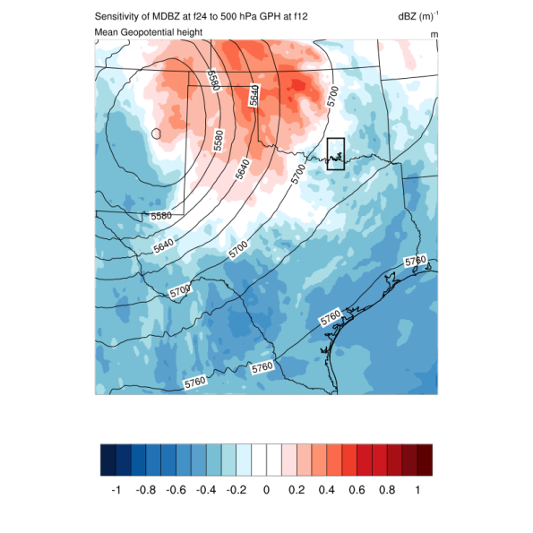
Convective Ensemble Sensitivity
12-hr
24-hr forecast position of dry line
dBZ/m
dBZ/m
Sensitivity of 24-hr reflectivity in box to 500-hPa GPH
(Mean 500-hPa GPH in countours)

Slide 13
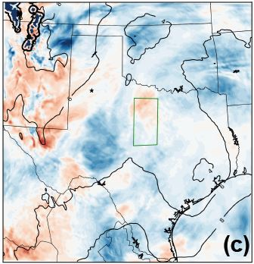
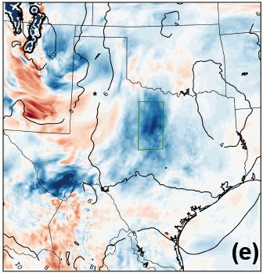

Convective Ensemble Sensitivity
dBZ/C
18 HR
24 HR
Sensitivity of maximum 24-hr simulated reflectivity in box to
700-hPa temperature

Slide 14
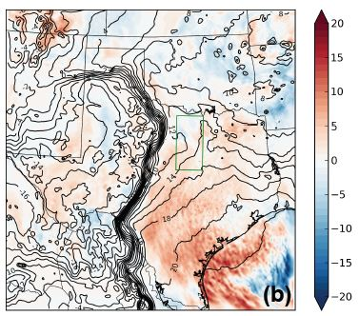
Convective Ensemble Sensitivity
12-hr
m/s/C
Sensitivity of maximum 20-hr vertical velocity in box to
2-meter dew point temperature
(Mean 2-meter dew point temperature in contours)

Slide 15
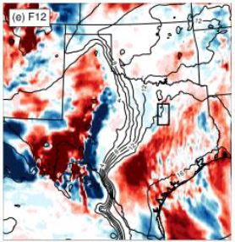
Convective Ensemble Sensitivity
→ Sensitivity-based subsetting benefits from statistical AND direct dynamical relationships…
L
12-hr
m/s/C
Sensitivity of 24-hr average reflectivity to 2-meter water vapor mixing ratio

Slide 16
Methodology
Sensitivity-Based Ensemble Subsets
Identify high-impact response at a later forecast time (e.g. 24 hr)

Slide 17
Methodology
Sensitivity-Based Ensemble Subsets
Identify high-impact response at a later forecast time (e.g. 24 hr)
Calculate ensemble sensitivity of response to atmospheric state at early forecast time (e.g. 6 hr)

Slide 18
Methodology
Sensitivity-Based Ensemble Subsets
Identify high-impact response at a later forecast time (e.g. 24 hr)
Calculate ensemble sensitivity of response to atmospheric state at early forecast time (e.g. 6 hr)
Compare all members against observations at the early forecast time

Slide 19
Methodology
Sensitivity-Based Ensemble Subsets
Identify high-impact response at a later forecast time (e.g. 24 hr)
Calculate ensemble sensitivity of response to atmospheric state at early forecast time (e.g. 6 hr)
Compare all members against observations at the early forecast time
Select ensemble subset of members with smallest errors in sensitive regions

Slide 20
Methodology
Sensitivity-Based Ensemble Subsets
Identify high-impact response at a later forecast time (e.g. 24 hr)
Calculate ensemble sensitivity of response to atmospheric state at early forecast time (e.g. 6 hr)
Compare all members against observations at the early forecast time
Select ensemble subset of members with smallest errors in sensitive regions
Compare skill of subset to full ensemble to measure the success of the technique

Slide 21
Sensitivity-Based Subsets: Synoptic-Scale
Idealized experiment for land-falling North American midlatitude cyclones for a full winter season (2009-2010):
  80-member ensemble
  8-member subset
  Response = 24-hr average cyclone central pressure
  Comparison to observations (RMS fit) at 6 hr over greatest 70% of ensemble sensitivity magnitudes
  Observations taken from model run within ensemble, assumed available everywhere

Slide 22
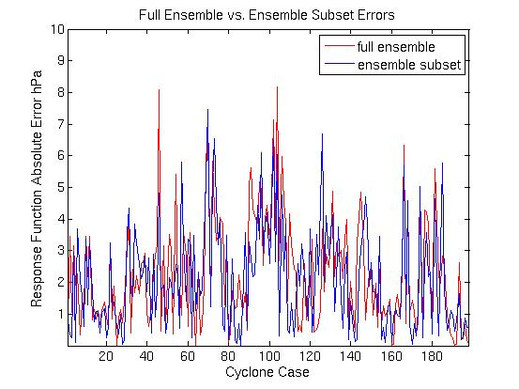
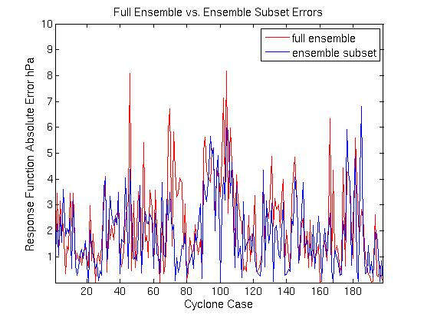
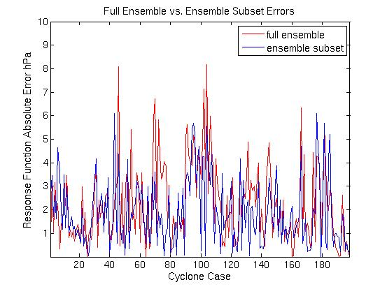
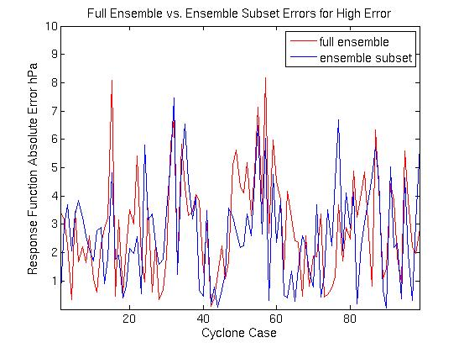
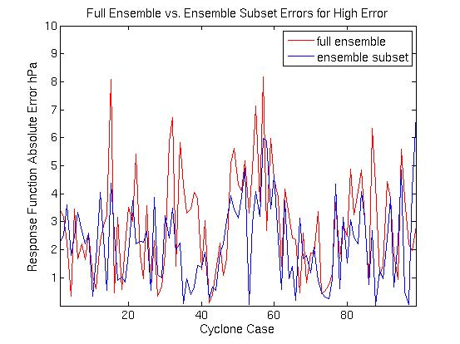
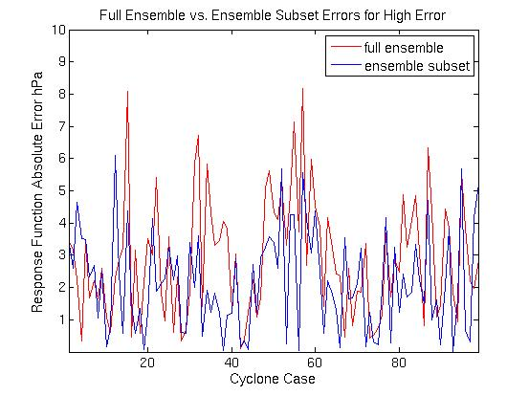
Sensitivity-Based Subsets: Synoptic-Scale
Error reduction 500GPH = 16%
850GPH = 20%
SLP = 20%
ALL CASES
500hPa GPH
850hPa GPH
SLP
Error reduction 500GPH = 20% 850GPH = 24% SLP = 24%
LARGEST SPREAD

Slide 23
Sensitivity-Based Subsets: Convective-Scale
→ Can synoptic-scale success be reproduced with surface-based convective sensitivity?

Slide 24
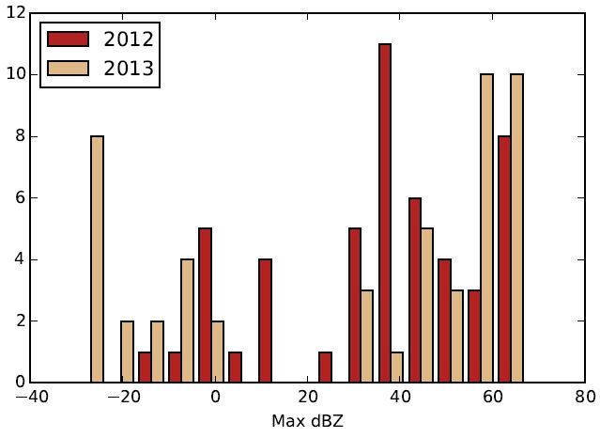
Sensitivity-Based Subsets: Convective-Scale
→ Can synoptic-scale success be reproduced with surface-based convective sensitivity?
R
X_{o}
The more non-Gaussian, the better (maybe)
Addresses a particular forecast problem (the influence of previous convection)

Slide 25
Sensitivity-Based Subsets: Convective-Scale
→ Can synoptic-scale success be reproduced with surface-based convective sensitivity?
  50-member DART EnKF, 4-km grid spacing
  6-hr cycling (with 48-hr spinup), 36-hr extended ensemble forecasts every 00, 12 UTC initialization June 2 – June 7
  Above week was final (and most active) week of Hazardous Weather Testbed (HWT) 2014 Spring Experiment

Slide 26
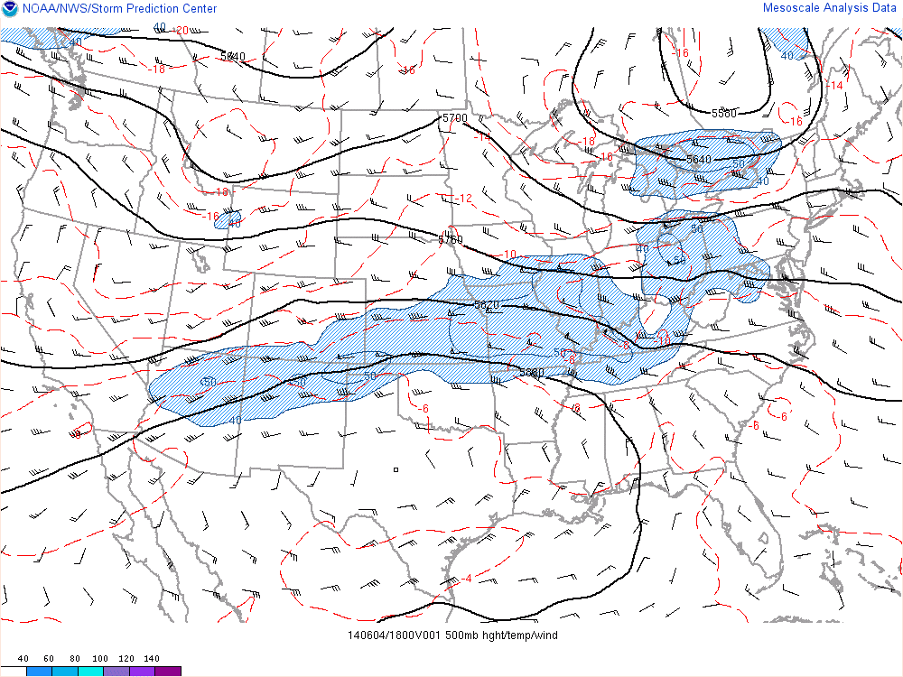
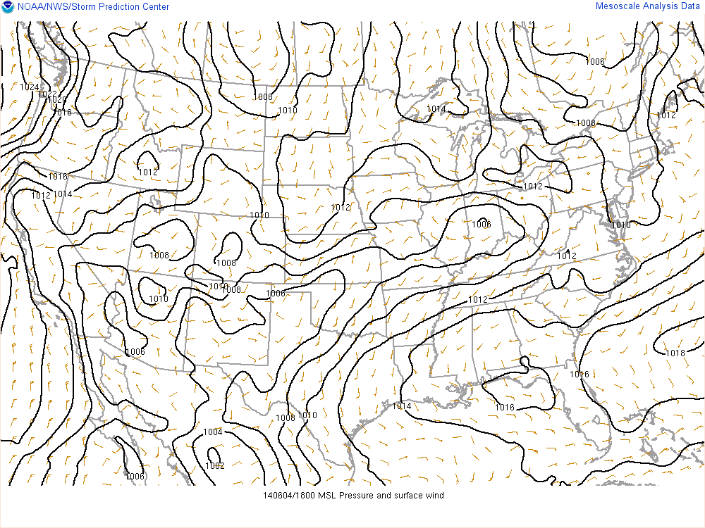
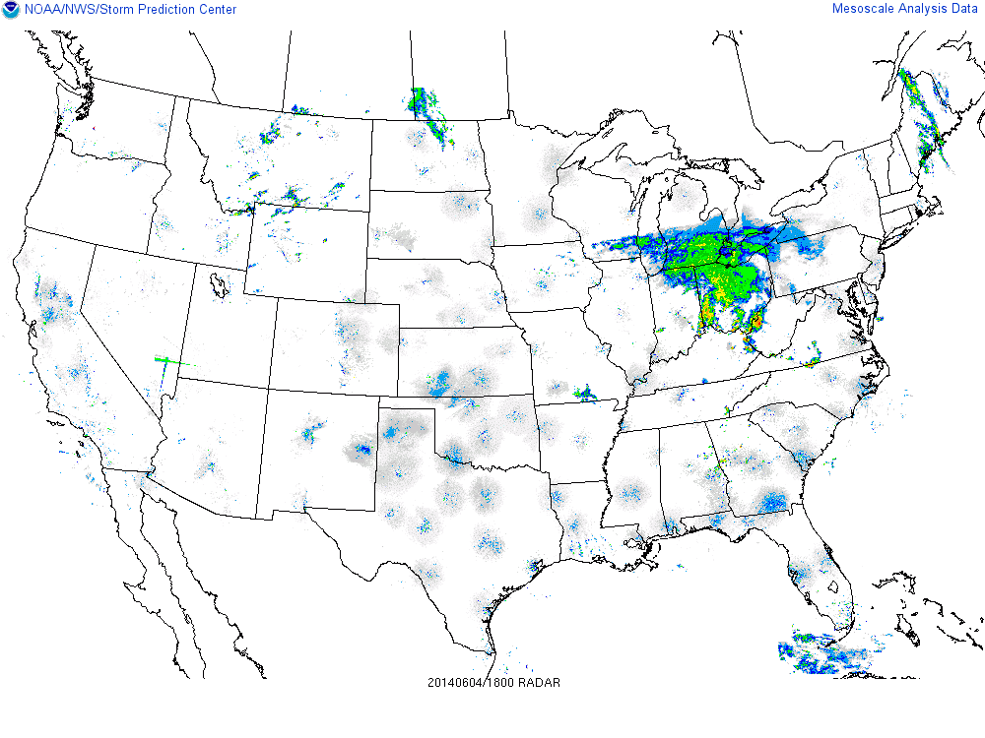
June 4-5, 2014 MCS Event
500 mb
SLP
Radar
18 UTC June 4

Slide 27
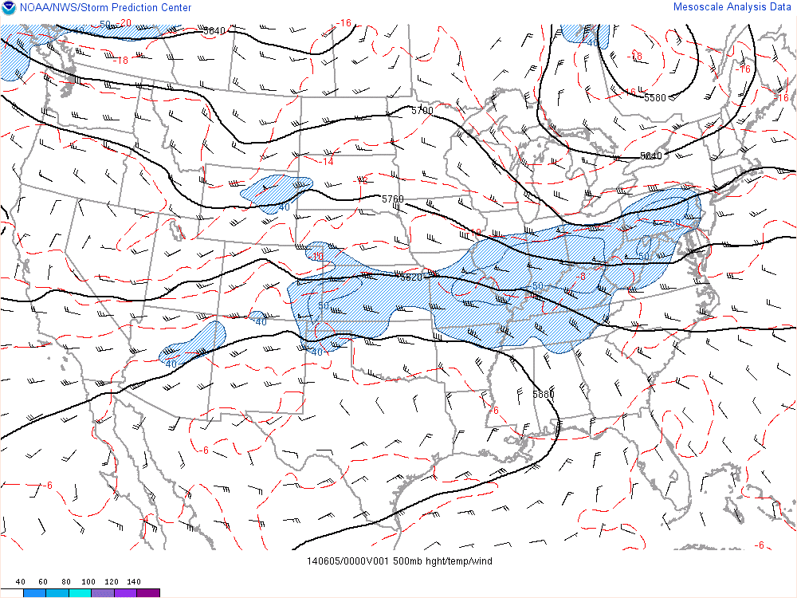
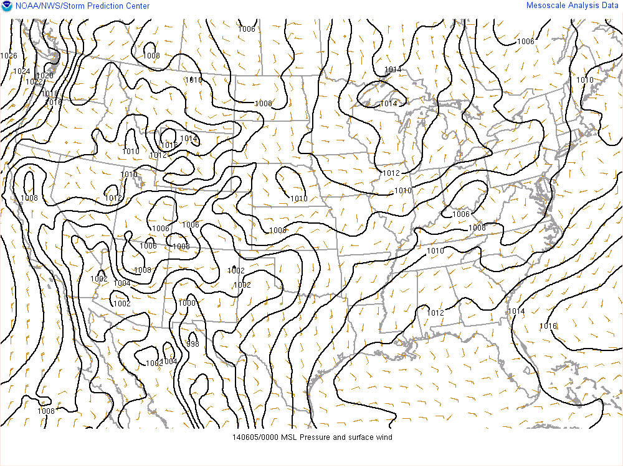
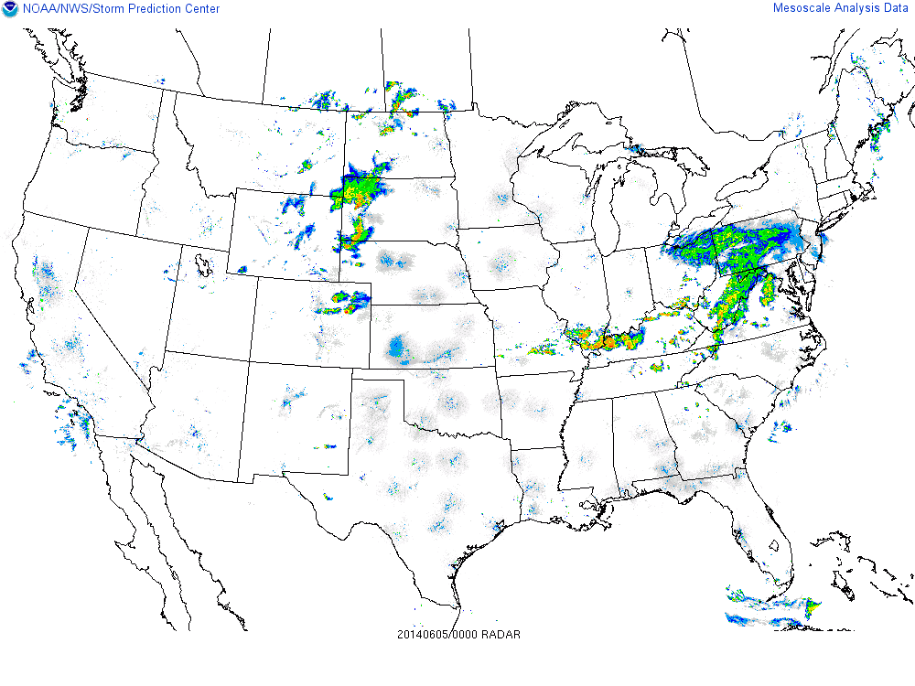
June 4-5, 2014 MCS Event
500 mb
SLP
Radar
00 UTC June 5

Slide 28
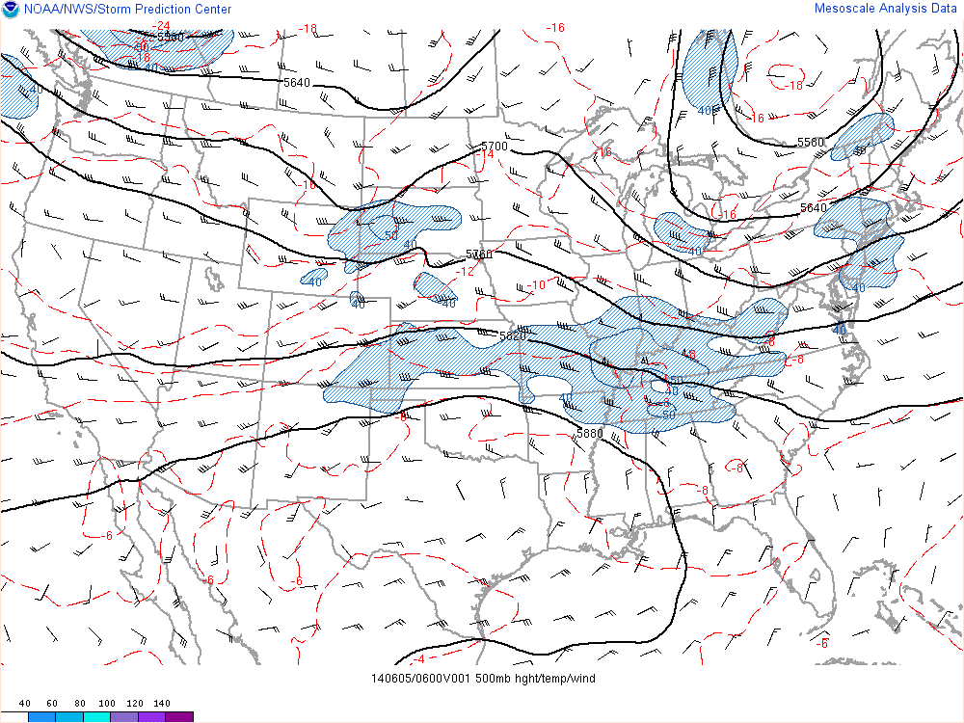
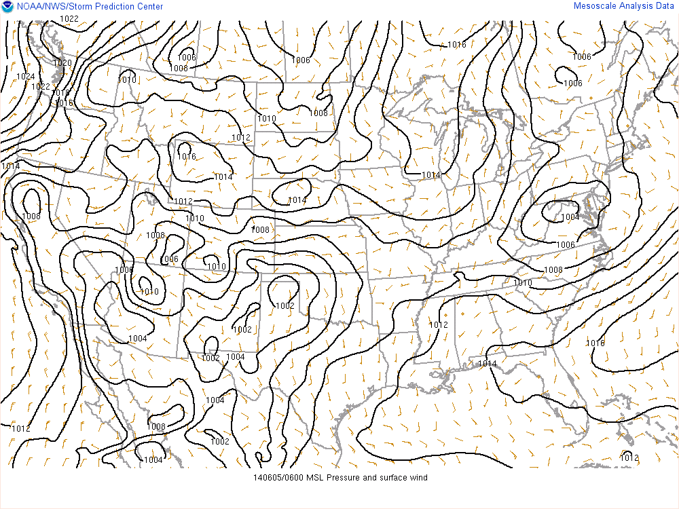
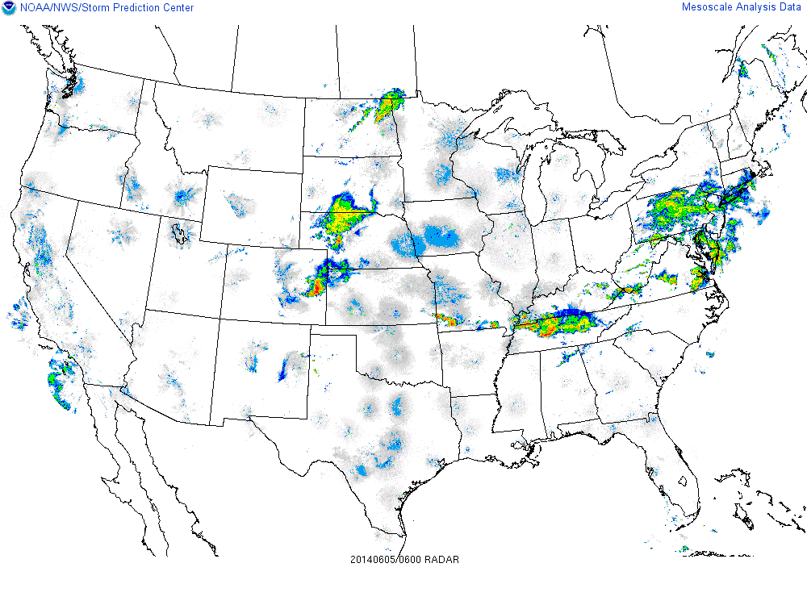
June 4-5, 2014 MCS Event
500 mb
SLP
Radar
06 UTC June 5

Slide 29
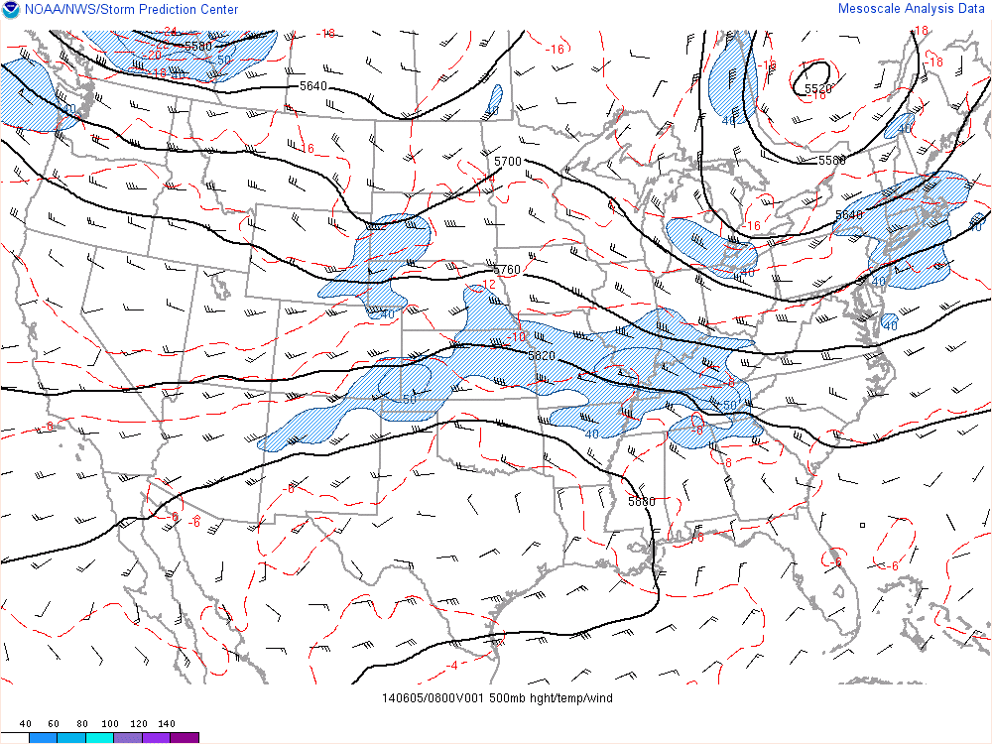
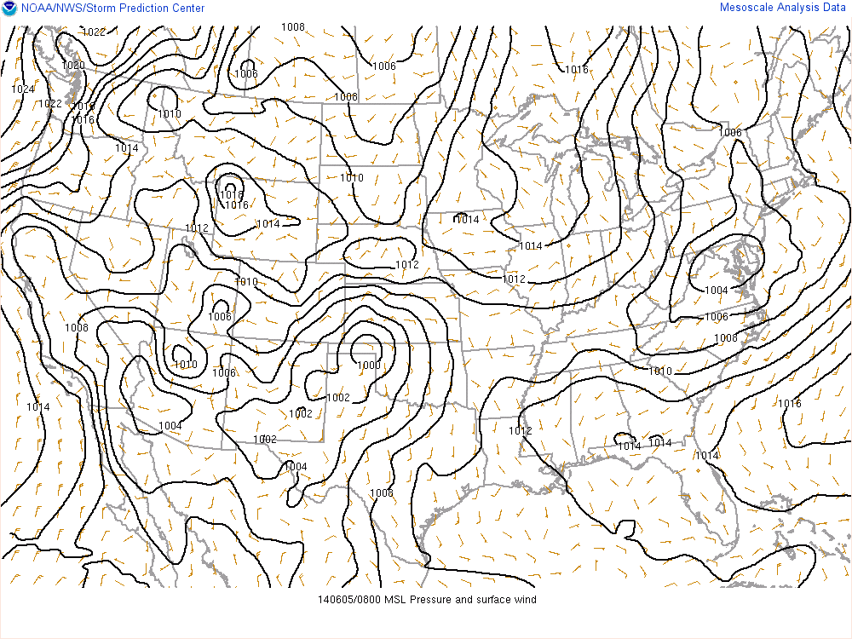
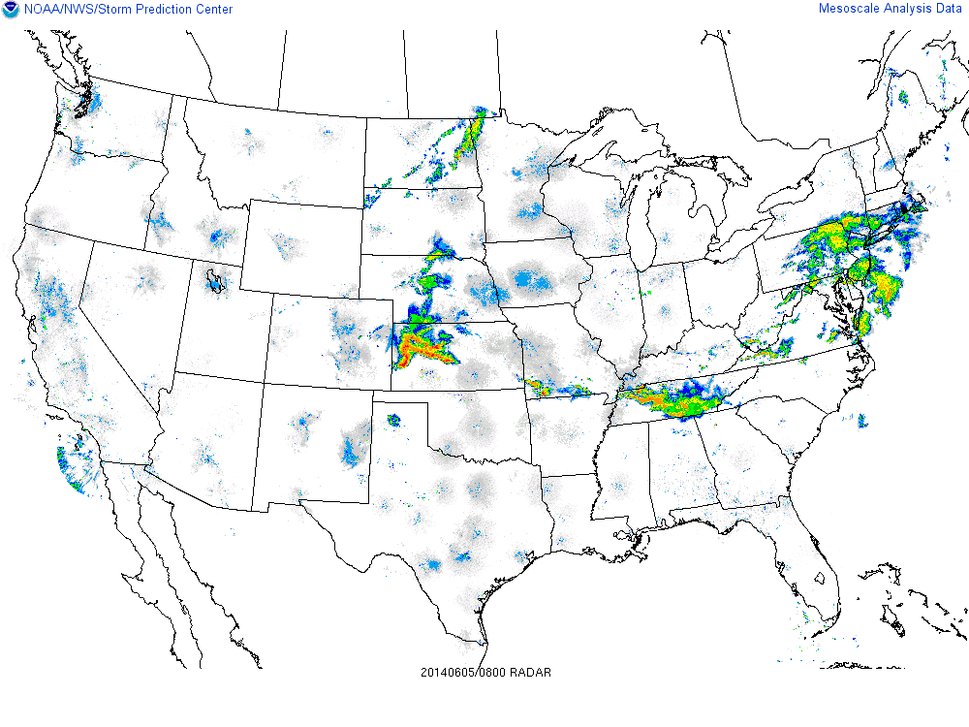
June 4-5, 2014 MCS Event
500 mb
SLP
Radar
08 UTC June 5

Slide 30
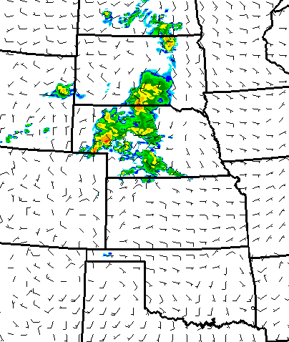
June 4-5, 2014 MCS Event
08 UTC June 5
Member 4
Member 22

Slide 31
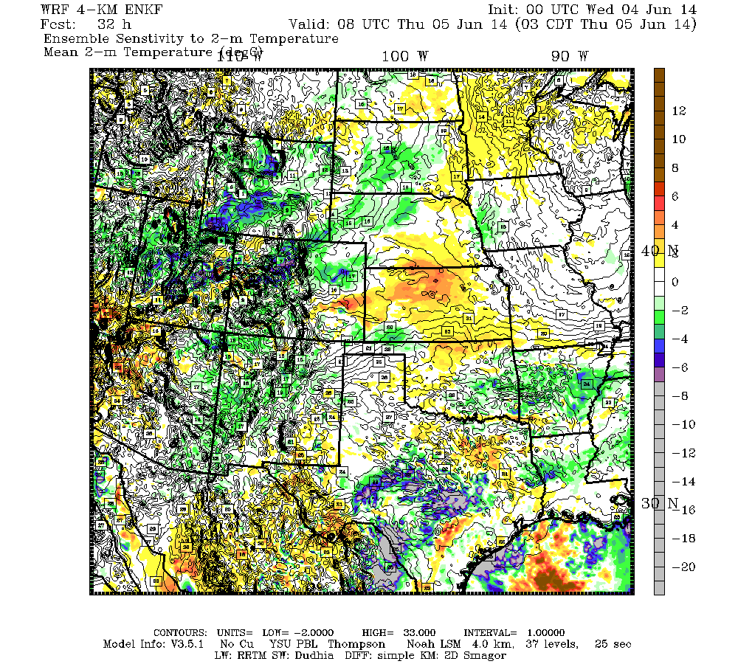
June 4-5, 2014 MCS Event
08 UTC June 5 (0 hrs prior)
Simulated Reflectivity (Mem 4)
Sensitivity to 2-m Temp
dBZ/C

Slide 32
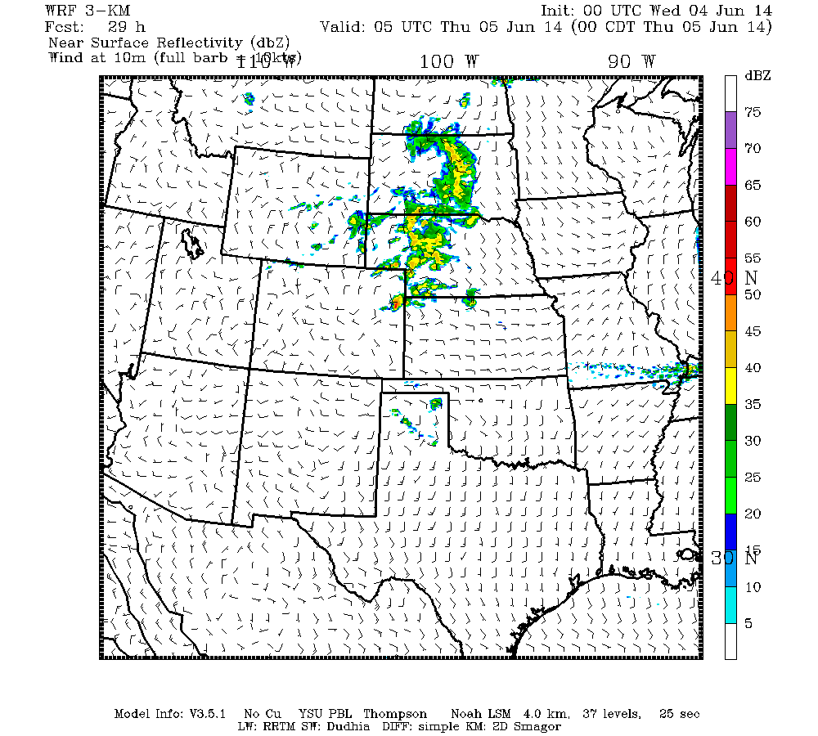
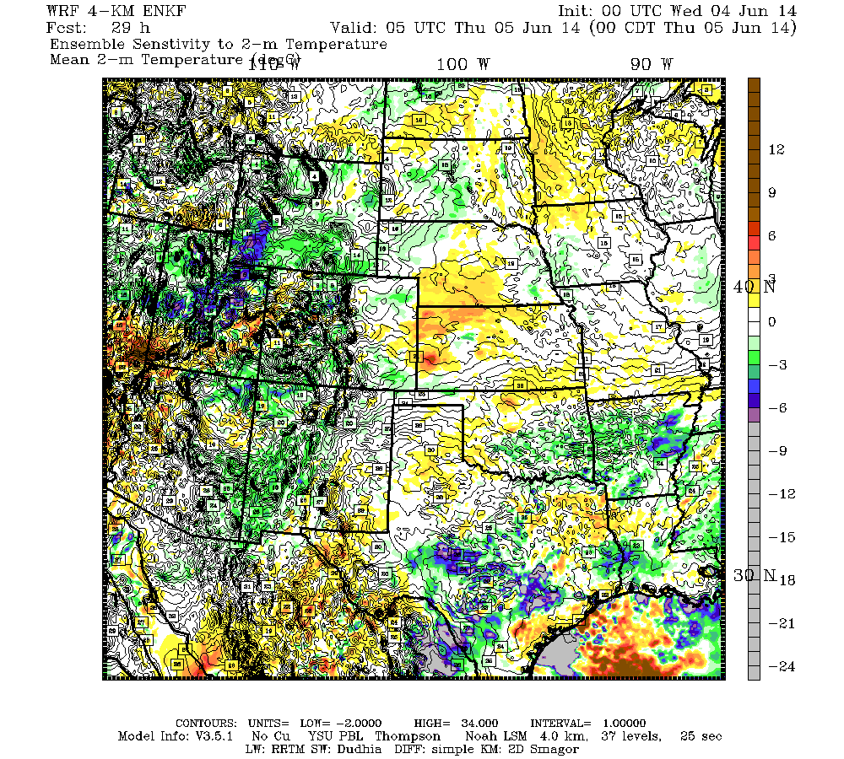
June 4-5, 2014 MCS Event
05 UTC June 5 (3 hrs prior)
Simulated Reflectivity (Mem 4)
Sensitivity to 2-m Temp
dBZ/C
→ Motivates further work at convective scales (highly nonlinear might be good!)

Slide 33
Summary
Choosing ensemble members based on the smallest ensemble sensitivity-weighted errors early in a forecast period may improve the predictability of high-impact events prior to subsequent data assimilation cycles
    Requirements:
    i) Ensemble sensitivity (rapid calculation)
    ii) Observations
Sensitivity-based subsets for idealized experiments at synoptic scales showed substantial improvements and motivates further development of technique
3) Convective-scale success likely depends on robust surface sensitivity signals, and may be better in a highly nonlinear, non-Gaussian framework

